Slide 1
Introducing Graph RAG
Enhancing language models with external knowledge
Guido Schmutz (Senior Manager & Architect)

Slide 2
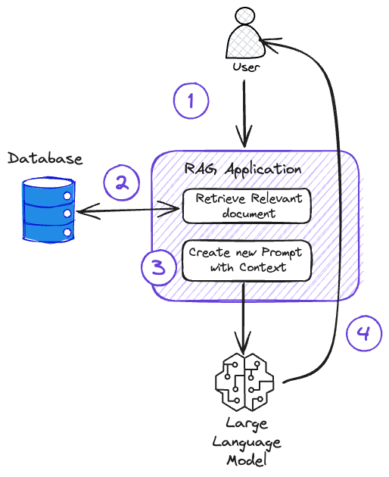
Retrieval Augmented Generation (RAG)
A software design pattern for integrating GenAI applications with custom data sources, like a database
RAG augments the LLM by intercepting a user’s prompt
a query to the database (knowledge base) is made
using the query results as context (a.k.a. grounding) for the user’s prompt, a new prompt is created that is passed to the LLM
LLM is used to create complete, curated response
Challenges:
What is the right context to enhance question?
What database/data model to use as the knowledge base?
Which large language model (LLM) to use to generate the answer?
Provide LLM with data it is not aware of (either because of time or data privacy)
No need to fine-tune the LLM to customize results => save time and money
Using local LLM’s, context (question and additional data) will not leave the company

Slide 3
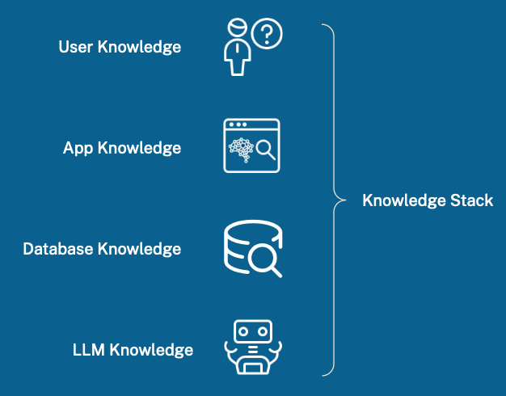
A Knowledge Stack
The user knows something about the question they’re asking
The application knows something about the user
The database knows about particular information and data
the LLM knows about whatever it found on the internet
Knowledge you control

Slide 4


The Sources of Data for (Graph) RAG
Each with different access patterns, supporting different kind of questions
Pure Text
Mixed
Text + Data
Pure Data
Unstructured data in PDFs, plain text files, or images
Structured data together with long form text
Highly structured documents
Structured data in a database
Source: Adapted from Neo4J

Slide 5
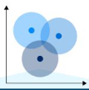
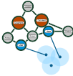
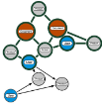
The Sources of Data for (Graph) RAG
Each with different access patterns, supporting different kind of questions
Pure Text
Mixed
Text + Data
Pure Data
Vector Search
Search & Pattern Matching
Graph Queries
Find relevant documents plus context for information search
Expand context and rank relevance for information discovery
Directly query the knowledge graph for information query
Graph RAG includes a graph database as a source of the contextual information sent to the LLM
Source: Adapted from Neo4J

Slide 6
Data Modeling Strategy
Start with a Minimum Viable Graph (MVG)
Create, Enhance, Connect then repeat to grow the graph
Create
identify interesting information, create records
Enhance
supercharge the data by enhancing some dimension
Connect
connect information to expand context and reveal knowledge

Slide 7

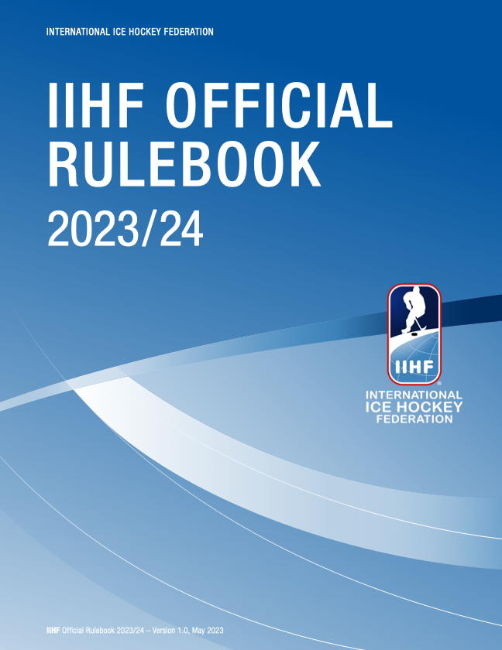
Demo Use Case – IIHF Official Rulebook
Let’s see if we can ask questions about the rules of ice hockey
No matter where ice hockey is played, the object of the game is the same – to put the puck into the opponent’s goal
The comprehensive IIHF rule book ensures a consistent set of rules for all, maintaining a fair and uniform standard of play globally, preserving the "language" of the game.

Slide 8
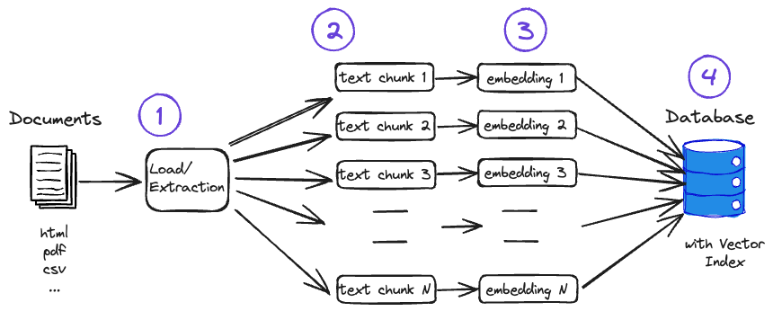
Preprocessing
An LLM has limited context window, therefore we have to provide it with the right information
Load the document(s) and extract the information (PDF) as text
Split text data into right-sized chunks to improve information retrieval and because LLM has a limited context window
Create embeddings for each chunk
Store embedding and corresponding text in a vector index in the database of your choice
Challenges :
How extract information from PDF?
What is the right chunking strategy and size?
Which embedding model to use?
Which (vector) database to use?
How to model the (knowledge) database?

Slide 9

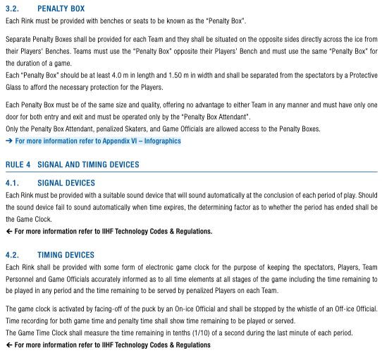
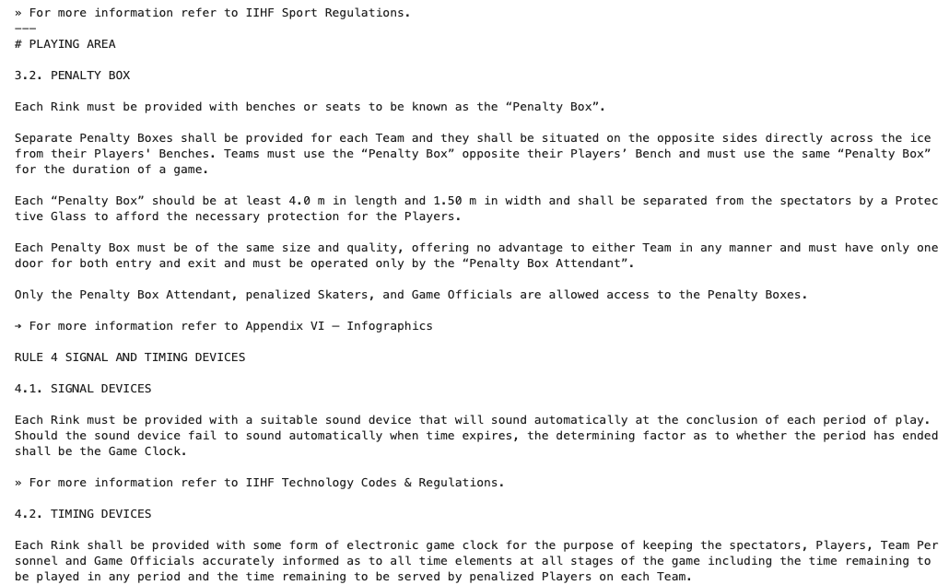
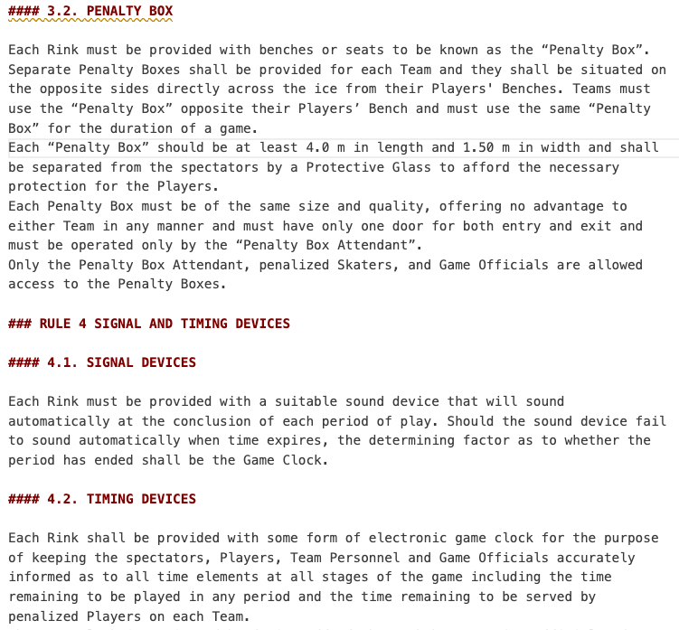
Preprocessing– Extract text from PDF
Convert PDF to a markup language such HTML or Markdown to simplify further processing
This is known to be a hard problem and I did not get a satisfying result with the options I have tried so far
Unstructured.Io
LLMSherpa
LLamaParse (example)
At the end I decided to manually convert the PDF into a markdown document

Slide 10
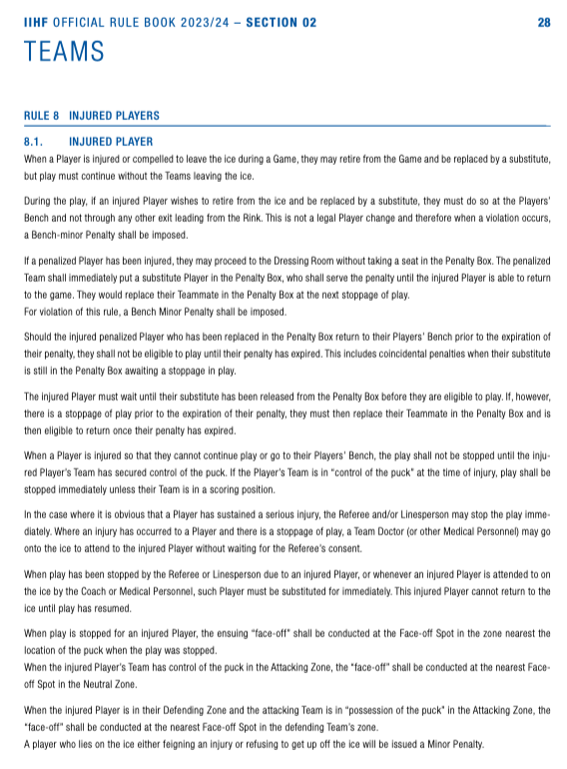
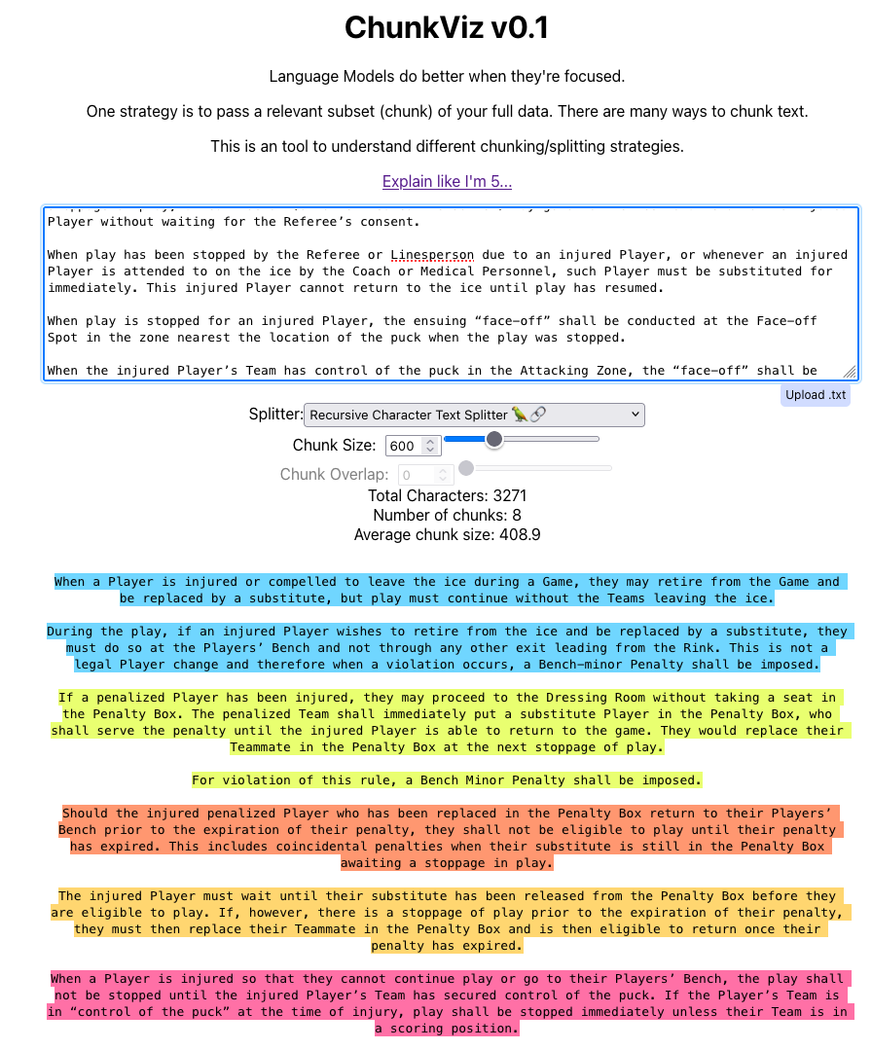
Preprocessing – Chunking Strategy and Size
Breaking up data into smaller pieces or chunks is a crucial step in a RAG solution
Chunking
https://chunkviz.up.railway.app/

Slide 11
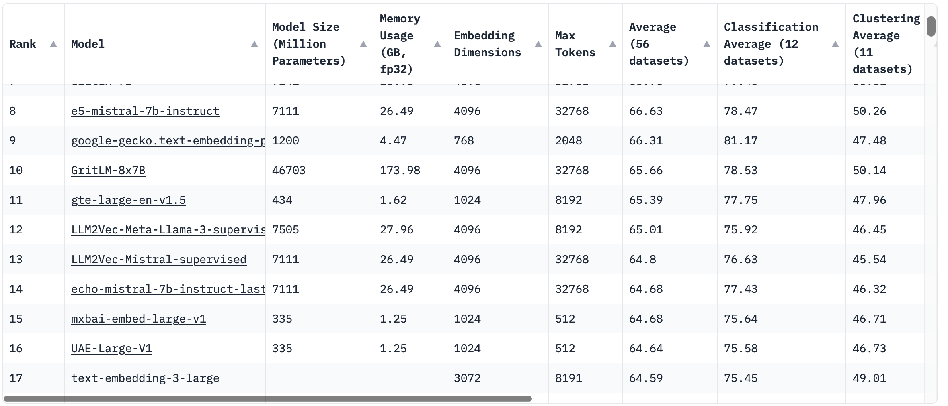
Preprocessing – Which Embedding Model?
Decided to use mxbai-embed-large-v1 as it is part of Ollama => max tokens = 512 must be taken into account when choosing chunk size => for each chunk we create an ebedding
https://huggingface.co/spaces/mteb/leaderboard

Slide 12
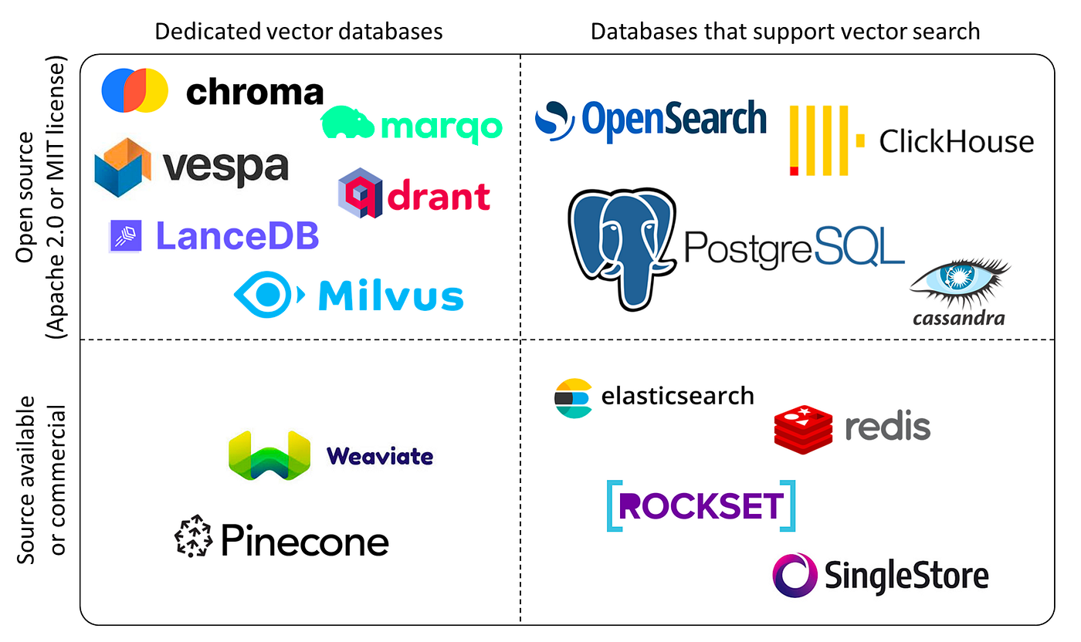

Preprocessing – Which Vector DB to use?
Using a graph database (Neo4J) combines vector searches with graph searches and traversal
Source: https://blog.det.life/why-you-shouldnt-invest-in-vector-databases-c0cd3f59d23c

Slide 13



Demo Use Case - Toolstack used
Neo4J
Ollama
Langchain
Platys
popular native graph database
Running LLMs locally
Simplify the creating of apps levering LLMs
Accelerator for setting up modern data platforms
Native Labeled Property Graph
Cypher Query Language
Graph Algorithms
Provides Vector Indices
Provides access to many high-quality LLMs
Can be installed on Mac, Windows or Linux
Uses GPU if available
Powerful tool for building LLM apps
provides components, such as prompt templates, chains, agents, memory, and document loaders
Integrates with various vector stores
Generate docker compose stacks
To be used for Proof-of-Concepts (PoC) or trainings
Very lightweight, runs on a single machine
Open Source

Slide 14
Preprocessing – Data Preparation
Traditional RAG with chunking on full text
e
[0.4,0.5,..]
[0.3,-0.3,..]
[0.6,-0.8,..]
[0.2,0.7,..]
[0.1,0.5,..]
[0.1,0.6,..]

Slide 15
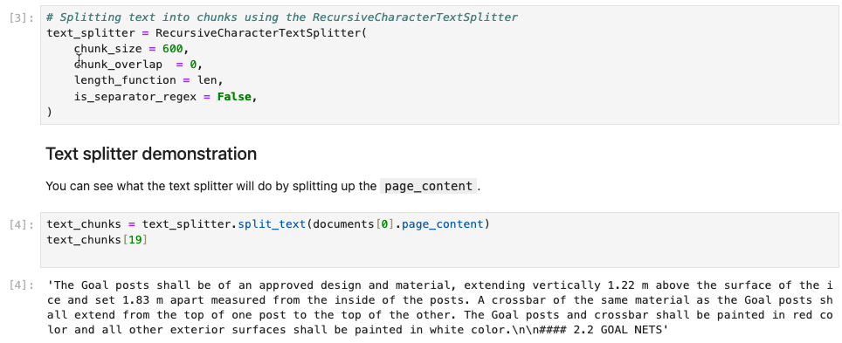
Preprocessing – Data Preparation
Using RecursiveCharacterTextSplitter to chunk on the full text

Slide 16
Data Modeling Strategy
Start with a Minimum Viable Graph (MVG)
Create, Enhance, Connect then repeat to grow the graph
Create
identify interesting information, create records
Enhance
supercharge the data by enhancing some dimension
Connect
connect information to expand context and reveal knowledge

Slide 17
Preprocessing – Data Preparation
Traditional RAG with consideration of document structure for chunking
[4,5,..]
[0.3,-0.3,..]
[0.6,-0.8,..]
[0.2,0.7,..]
[0.1,0.5,..]
[0.1,0.6,..]

Slide 18
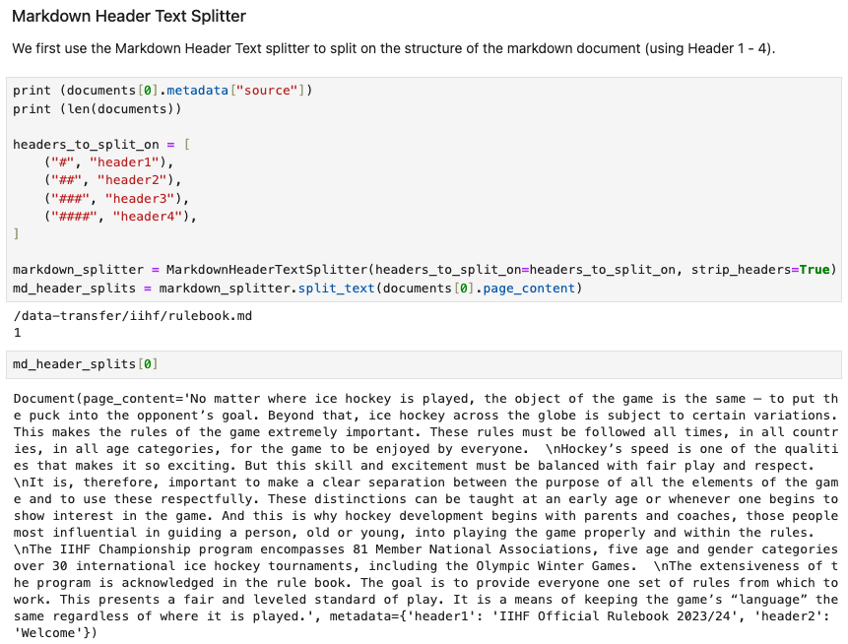
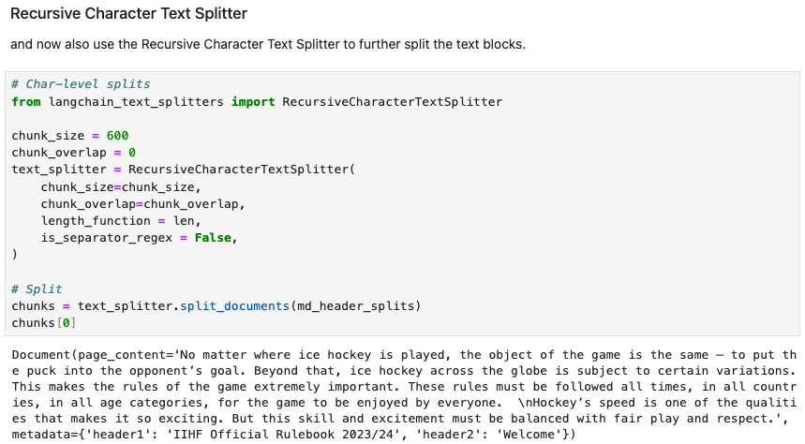
Preprocessing – Data Preparation
Using MarkdownHeaderTextSplitter with RecursiveCharacterTextSplitter to chunk text of section

Slide 19
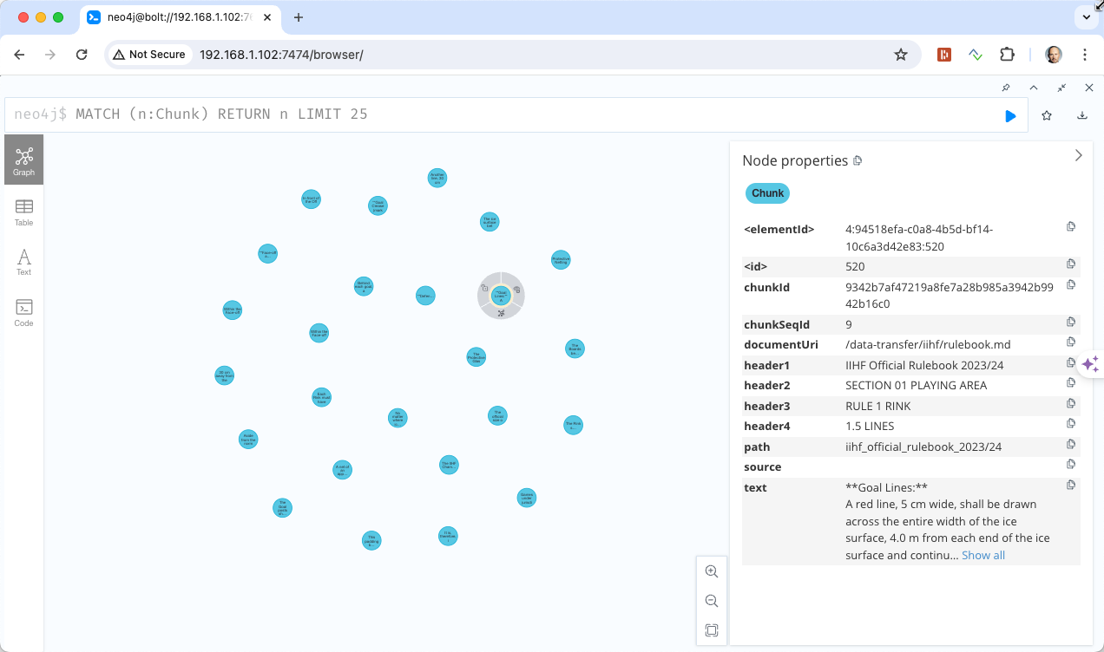
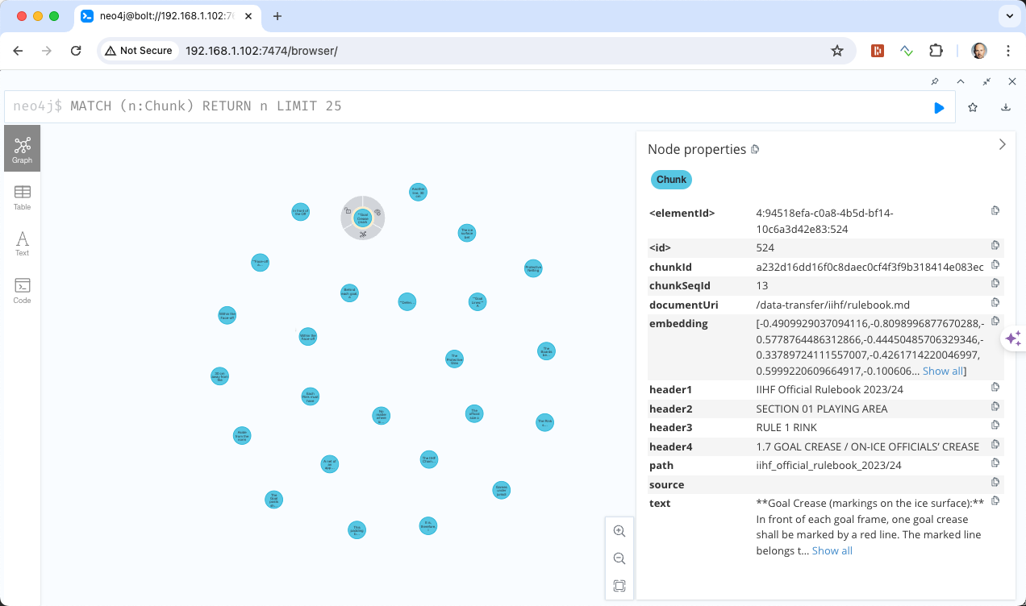
Preprocessing – Data Preparation
Chunks with the embeddings as loaded into Neo4J

Slide 20
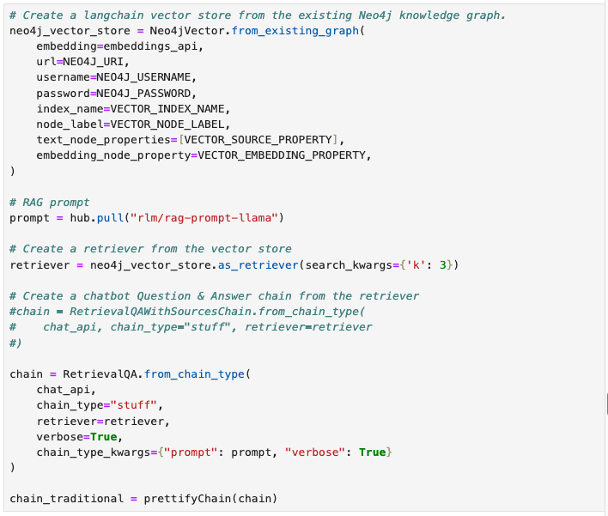
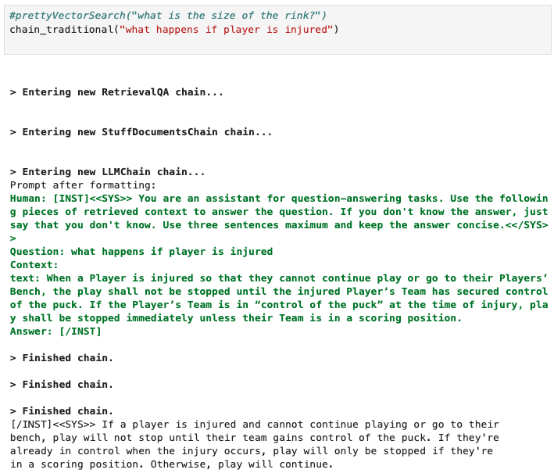
Testing RAG Chain
Of the Traditional RAG Strategy

Slide 21
Preprocessing – Data Preparation (II)
Traditional RAG enhanced with Linked List of chunks => first step of Graph RAG
Benefits:
Vector similarity search to find relevant text
Expand context window with previous/next chunks
Enable paging through text
Chunking no longer requires the chunks to overlap
Chunk
chunkId: string
documentUri: string
text: string
ebmbedding: float[]
NEXT

Slide 22
Preprocessing – Data Preparation (II)
9
Traditional RAG enhanced with Linked List of chunks
[0.3,0.6,..]
?
10
[0.4,0.5,..]
11
[0.3,-0.3,..]
12
[0.6,-0.8,..]
13
[0.2,0.7,..]
14
[0.1,0.5,..]
15
[0.1,0.6,..]
?

Slide 23
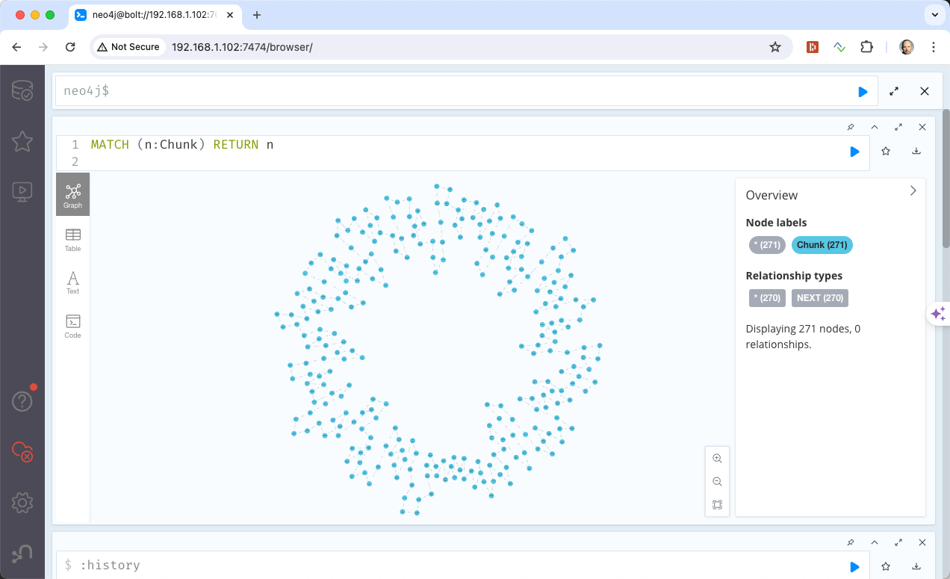
Preprocessing – Data Preparation
Chunks as linked list loaded into Neo4J

Slide 24
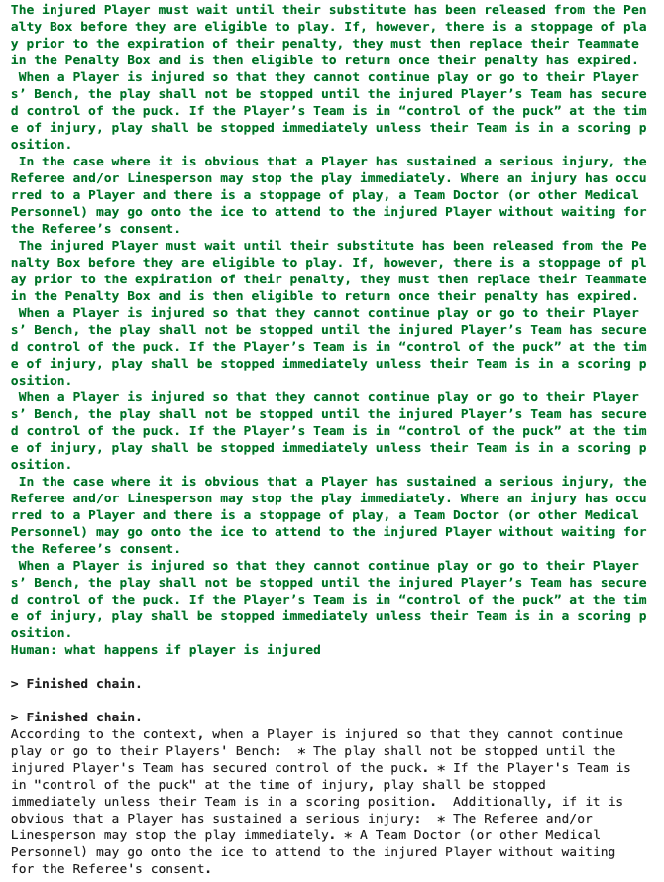
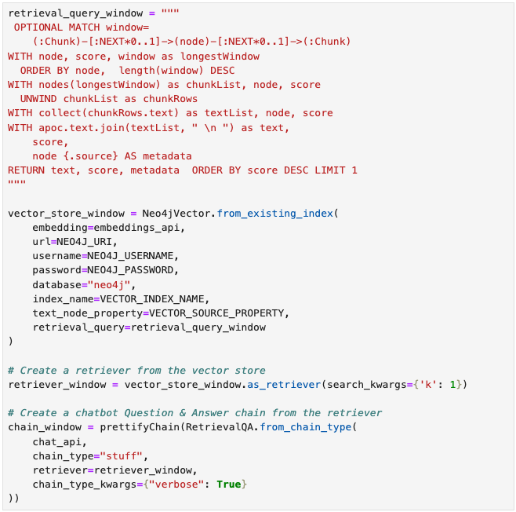
Testing RAG Chain
Of the Traditional RAG Strategy with Query Window

Slide 25
Preprocessing – Data Preparation (III)
Enhance graph with structure to support Parent Retriever strategy
documentId: string
documentUri: string
Section
Document
Create Section nodes for each Section (Header 1 – 4) and a Document node for the document
Connect from Section to all Chunk Nodes
Benefits:
Get all ”sibling” chunks by traversing up from the most relevant chunk to the section and back to all other nodes
We can also do that ordered so that the NEXT relationship is no longer needed
Enhanced context with more relevant information
CONTAINS
sectionId: string
documentUri: string
text: string
CONTAINS
CONTAINS
Chunk
chunkId: string
documentUri: string
text: string
ebmbedding: float[]
NEXT

Slide 26
Preprocessing – Data Preparation (III)
Enhance graph with structure to support Parent Retriever strategy
D
9
H4
H1
10
H2
11
H3
12
H4
13
H4
14
15

Slide 27
Preprocessing – Data Preparation (III)
D
Enhance graph with structure to support Parent Retriever strategy – Remove linked list
H4
H1
10
H2
11
H3
12
H4
13
H4
14
15

Slide 28
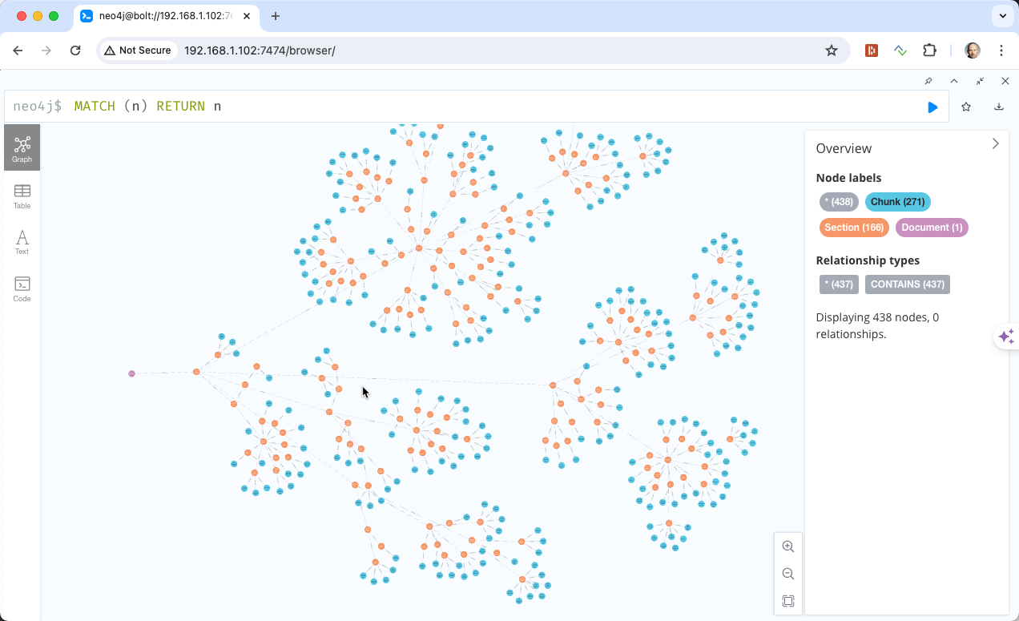
Preprocessing – Data Preparation (III)
Graph with Chunks, Section and Document

Slide 29
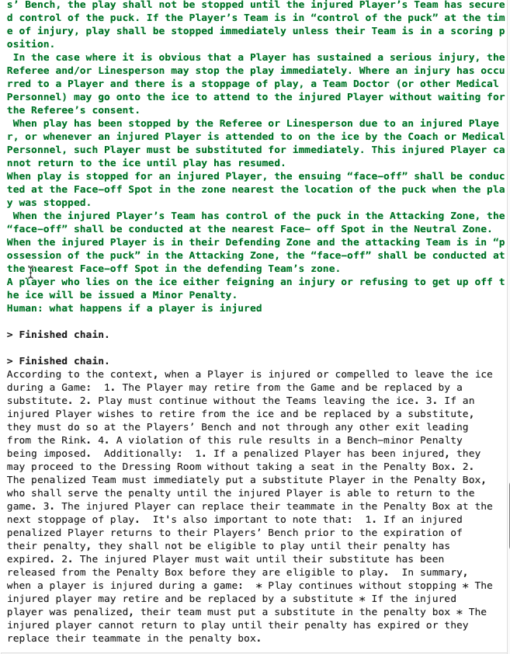
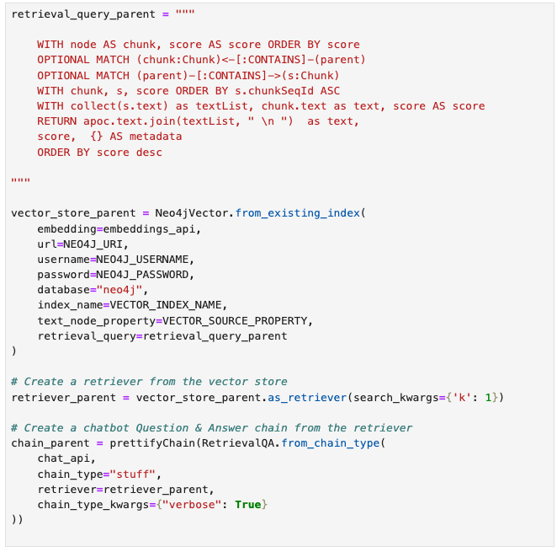
Testing RAG Chain
Of the Traditional RAG Strategy with Query Window

Slide 30
Preprocessing – Data Preparation (IV)
sectionId: string
documentUri: string
text: string
summary: string
embedding: float[]
Parent Retriever Strategy by enhancing sections with summary
Section
Document
Use LLM to generate summaries for all chunks of a given section
Add the summary and its ebeddings to the Section node
Benefits:
Summary has its own embeddings and can be another path to find the most relevant section
CONTAINS
CONTAINS
documentId: string
documentUri: string
CONTAINS
Chunk
chunkId: string
documentUri: string
text: string
ebmbedding: float[]
NEXT

Slide 31
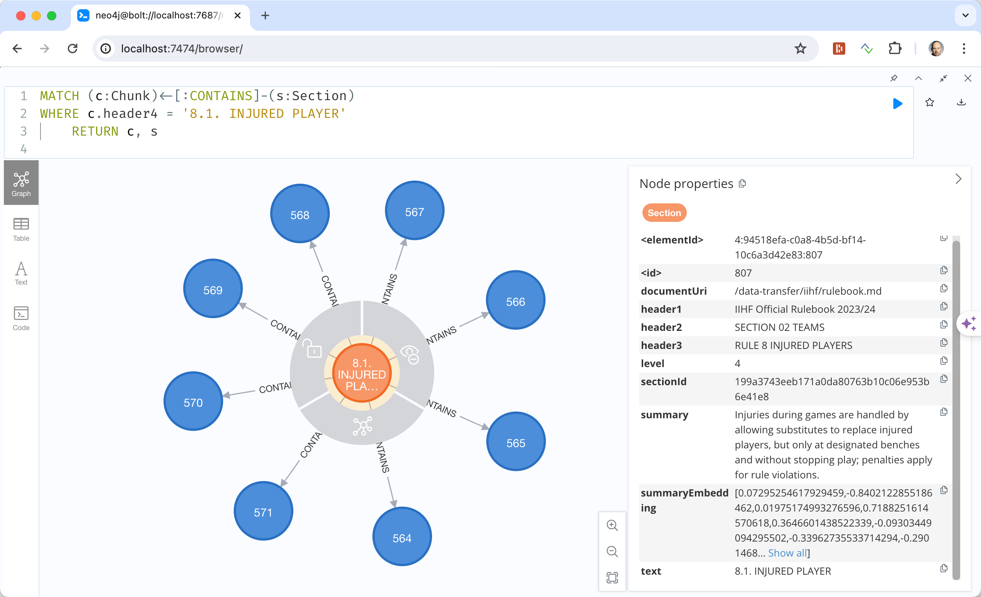
Preprocessing – Data Preparation (IV)
Section nodes enhanced with with summary and its embeddings

Slide 32
Preprocessing – Data Preparation (V)
sectionId: string
documentUri: string
text: string
summary: string
embedding: float[]
Hypothetical Questions Strategy by enhancing sections with summary
Section
Document
Use the LLM to generate hypothetical questions somebody might ask and add it to the graph
Calculate and add an embedding to each question
Benefits:
Each quesition has its own embeddings and can be another path to find the most relevant section
CONTAINS
CONTAINS
documentId: string
documentUri: string
CONTAINS
HAS_QUESTION
Question
Chunk
questionId: string
question: string
embedding: float[]
chunkId: string
documentUri: string
text: string
ebmbedding: float[]
NEXT

Slide 33
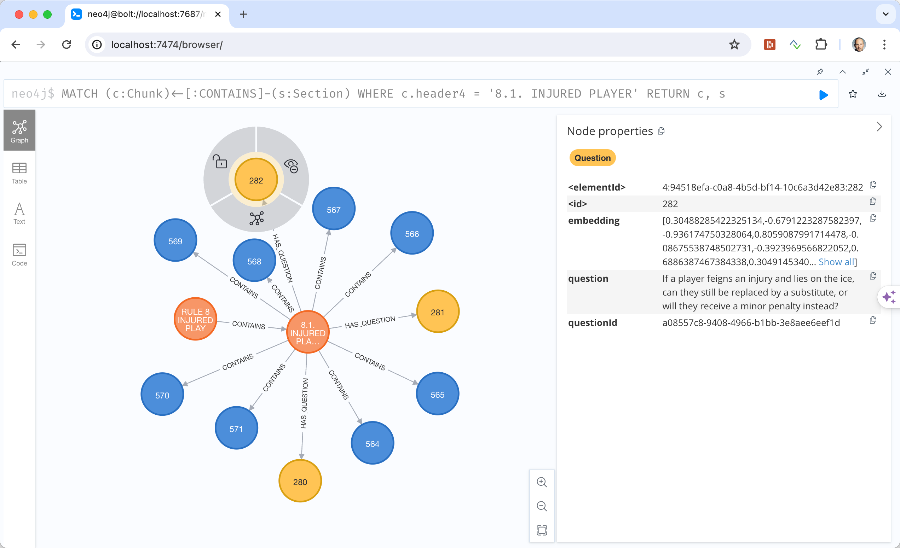
Preprocessing – Data Preparation (IV)
Graph enhanced with Question nodes for each generated hypothetical question

Slide 34
Summary & Outlook & Ideas
Thanks to the Neo4J people for all the material that served as inspiration
Summary
a very fast moving field with a vibrant community (blogs, youtube, discord)
Parsing and extracting the structure of a PDF document is hard
With knowledge graph we can enhance context by relevant information and increase quality of the responses from the LLM
Everything works locally -> no data left my machine
Outlook & Ideas
Further invest into PDF extraction techniques and libraries
More testing and evaluation
Build a UI with streamlit
Further enhance knowledge graph with entity extraction (Entities as nodes)
Use a separate Embedding node for all embeddings on all nodes

Slide 35
References
Chunk Visualizer on Hugging Face: https://huggingface.co/spaces/m-ric/chunk_visualizer
Chunk Viz: https://chunkviz.up.railway.app/
Neo4J: https://neo4j.com/
Ollama: https://ollama.com/
Langchain: https://www.langchain.com/
Platys: https://github.com/trivadispf/platys and https://github.com/TrivadisPF/platys-modern-data-platform

Slide 36
Thank you!

